Slide 1
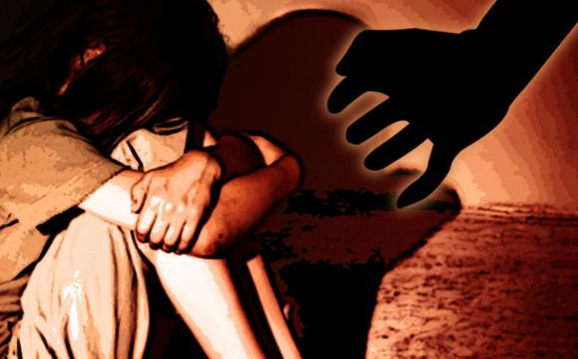
SEXUAL VIOLENCE
AGAINST WOMEN
IN NEW DELHI

Slide 2
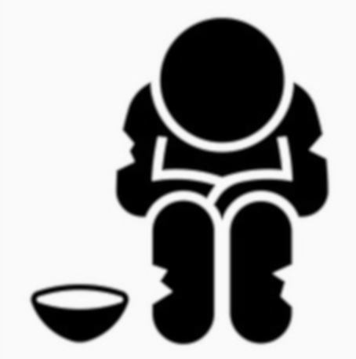
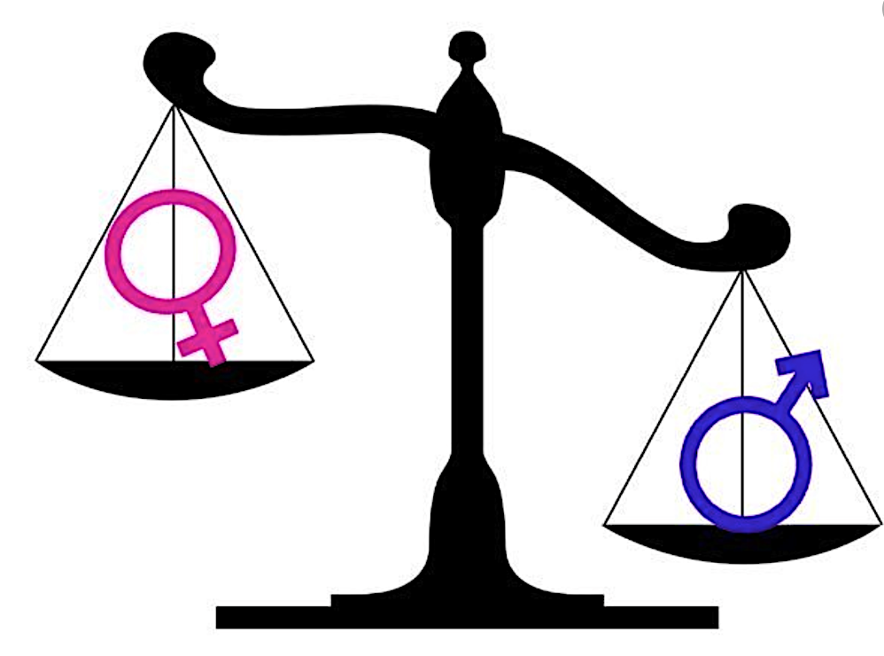
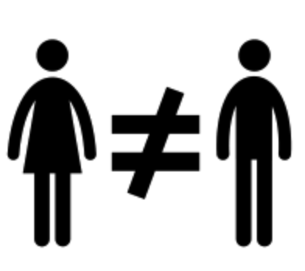
THE ICEBERG MODEL
Delhi – The rape capital of the world
EVENTS
A woman or girl is raped every five hours in Delhi
Conviction rate for
rape cases has dropped
in past thirty years
No. of rape cases
pending in courts
20%
90%
PATTERNS
Poverty
Corruption
1.7 million people live
below the poverty line
81st most corrupt
country
Caste System
UNDERLYING
STRUCTURES
Bare Branches
Weak Law Enforcement
4 Dalit women
are raped every
day in India
869 females per
1000 males
Average safety score
is 3.3/5
Patriarchy: Perception of
women as inferior
Pre-defined roles in society
for both men and women
MENTAL MODELS
6/70 seats in Delhi MLA
are held by women
Women form only 12.19%
of the city's workforce

Slide 3
BACKGROUND RESEARCH AND STAKEHOLDER INTERVIEWS
30+ Interviews
Leslee Udwin
Director of BBC Documentary
– “India’s Daughter”
Swati Maliwal
Chairperson – Delhi Commission for Women
Summit Saurav
Lead Analyst
- Ola Cabs (Ex)
80+ Reports
Sutapa Sanyal
Ex – Director General
- Uttar Pradesh
Roshan Shankar
Policy Coordinator
- Aam Aadmi Party
Vijaya Rukmini Rao
Executive Director - Gramya Resource Centre for Women
100+ Perpetrator Accounts*
Nida Hasan
Country Director
- Change.org
Megha Bisaria
Associate Producer
- Freelance
Prageeya Khanna
Gender Advocacy Director
- She Says India
*Sourced from interview reports conducted with perpetrators

Slide 4
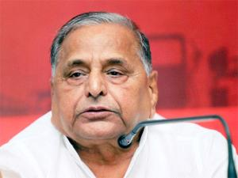
STAKEHOLDER PERSPECTIVES: SETTING THE NARRATIVE
First girls develop friendship with boys. Then when differences occur, they level rape charges. Boys commit mistakes. Will they be hanged for rape?
A girl is far more responsible for rape than a boy. Boy and girl are not equal. Housework and housekeeping is for girls, not roaming in discos and bars at night.
- Mulayam Singh Yadav
Politician
Mukesh Singh
Nirbhaya Rapist

Slide 5
A SYSTEM THAT PROMOTES GENDER INEQUALITY
Normalizes objectification on screen
Sets behavioral norms
Join society conditioned to feel inferior
Fails to provide safe infrastructure
SOCIETY
GIRLS/
WOMEN
GOVERNMENT
Ascribe traditional roles
Reinforce stereotypes through differential treatment
Join society conditioned to feel superior
Sets outdated & inadequate curriculum
Elevate status at home
MEDIA
PARENTS
Prevent from providing education on sex and equality
Promotes voyeurism & stalking through films
BOYS/
MEN
TEACHERS
Do not teach gender sensitization

Slide 6
A SYSTEM THAT NORMALIZES SEXUAL ASSAULT
Unable to provide adequate support
Blames the victim
Use biased & derogatory language in court
Unable to spread awareness
SOCIETY
Apathetic to violence
VICTIM
LAWYERS
Abstains from reporting
Don’t register all cases
Slow to file charge sheet
Make court proceedings long & tedious
Women are not encouraged to run for public office
Sexually Assaults Woman
Does not prioritize women’s safety or gender equality
POLICE
NGOs
Ill-equipped to pursue all cases
Exercises control using power & bribery
GOVERNMENT
Provides low funding for women’s safety/gender equality
PERPETRATOR
COURTS
Underutilizes funds allocated to make courts more efficient

Slide 7
THE MENTAL MODELS AND UNDERLYING STRUCTURES THAT SUPPORT THE SYSTEM
HARMFUL RELIGIOUS
PRACTICES
PATRIARCHAL
BELIEFS
LACK OF
EDUCATION
CASTE- BASED
SEGREGATION
SOCIAL STIGMA
ECONOMIC
DISADVANTAGE

Slide 8
THE SOLUTIONS LANDSCAPE
EDUCATION
POLICY
LEGAL
TECHNOLOGY
INFRASTRUCTURE
Early childhood development
Gender sensitization
Positive sexuality training
Zero-tolerance in schools and workplace
Policies mandating quota of women representation
Stronger enforcement of acts such as POCSO and Nirbhaya
Expedition of the legal process
SOS emergency lines to report harassment
Use of platforms like Twitter to convey the message
Improved physical infrastructure like lighting, public transport
Social infrastructure like women's self-help groups
Curative
Preventative
Long Term
Short Term

Slide 9
GAPS AND LEVERS OF CHANGE
SOLUTIONS
GAPS
LEVERS OF CHANGE
Lack of Prioritization &
Implementation
Prioritize Gender Equality
Through Different Media
Lack of Sensitivity &
Support
Create a Safe & Reliable Space for
Women to Fight Against Assault
Shortfalls in Staffing &
Representation
Increase the Agency & Representation
of Women Across Sectors
Lack of Knowledge,
Awareness, & Accessibility
Develop Effective Campaigns
for Information Dissemination

Slide 10
GLOBAL STRATEGIES
Where?
What?
Who?
Scale:
Outcome:
Brazil
Gender Sensitization (Education)
Young Men
34 Countries
Men shown to less likely support gender norms after completion
Where?
What?
Who?
Scale:
Outcome:
Canada
Women Empowerment (Education)
Young Women
1 Country
Reduction in instances of rape

Slide 11
LESSONS LEARNT
COMPLEXITY
SCALE

Slide 12
NEXT STEPS
1
FURTHER RESEARCH TO IDENTIFY WAYS TO DECREASE UNDERREPORTING OF CASES
2
ALIGN STAKEHOLDER MOTIVATIONS WITH SOLUTIONS FOR EFFECTIVE IMPLEMENTATION
3
IDENTIFY OVERLAPS OF CURRENT SYSTEM DYNAMICS IN DIFFERENT GEOGRAPHIES & SETTINGS

Slide 13
THE PROBLEM PERSISTS
Nirbhaya gangrape case was blown out of proportion by the media
- Sheila Dikshit
Ex-CM (Delhi) and Congress Party Leader

Slide 14
THANK YOU!

